Slide 1
Lecture 6
Economics of online security

Slide 2
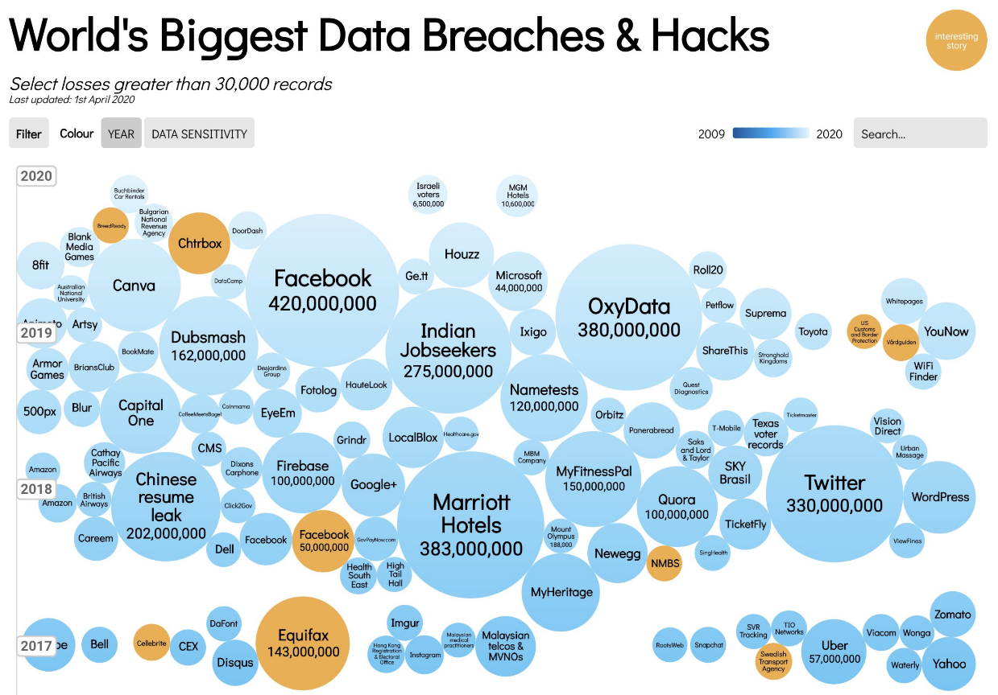
Title: Presentation
Subtitle field

Slide 3
Why so many security breaches?
Title: Presentation
Subtitle field
Negative externalities (already discussed)
Information asymmetries
Public good
Business models

Slide 4
Information asymmetries
Title: Presentation
Subtitle field
Online security is a “belief” goods
Uncertainty surrounding the processing of personal data
“black-box” society
User behavior in the face of this market imperfection:
Aware of potential risk
However, overall behavior is risky: overconfidence in the legal compliance of websites.

Slide 5
Security as an economic good
Title: Presentation
Subtitle field
Public good: non-rival, difficult to exclude
When an agent invests in security, all the agents in the market benefit, but only recovers a small part of the gains to society.
The problem of the free-rider in an eco-system: it's in his interest to let others invest for him.
The market is therefore subject to under-investment.
Because of information asymmetries, companies are also encouraged to use the cheapest security solutions.

Slide 6
The importance of business models
Title: Presentation
Subtitle field
The digital economy operates on a “winner takes all” principle.
The security of a company IT systems will not be the determining factor in its success or failure.
On the contrary, its ability to mobilize a large user base as quickly as possible guarantees a dominant market position.
Consequence: the consumer as beta tester

Slide 7
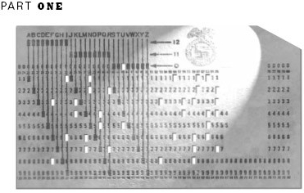
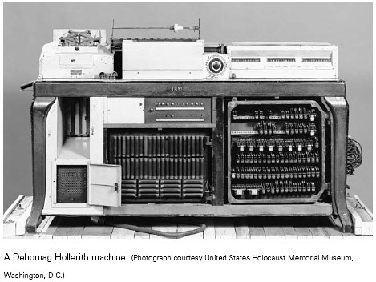
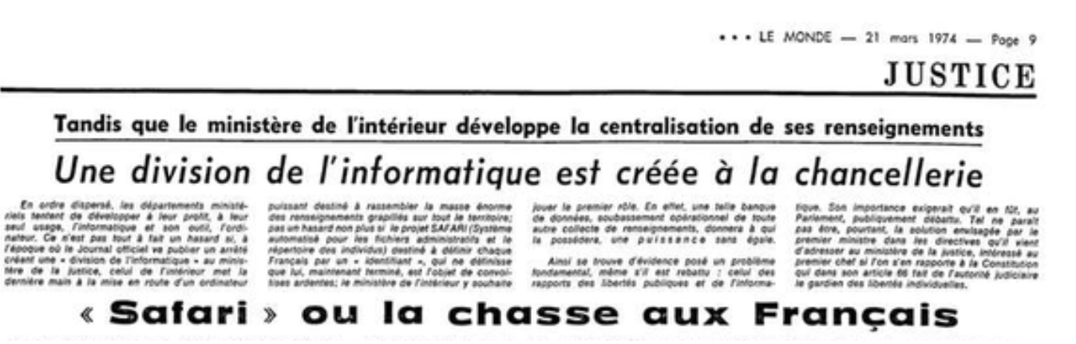
Loi informatique et libertés 1978
Title: Presentation
Subtitle field
World war II: IBM DEHOMAG (punch cards with racial features to identify jews among others)
1974, Le Monde: “SAFARI ou la chasse aux Français », creation of a unique ID database
Personal data:
Definition
Data controller
Purpose
Right to rectification
No fully automatic processing

Slide 8
GDPR
Title: Presentation
Subtitle field
Territoriality
Portability
Accountability
Increased penalties
Shared responsibility with subcontractors
Right to be forgotten
Privacy be design, by default
Data minimization
Privacy impact assessment
Class actions

Slide 9
Title
Subtitle

